Slide 1
Assignment:
Formal deconstruction of an
old master style painting

Slide 2
Formal deconstruction of an
old master style painting
Goal: Deconstruction. To deconstruct is to take something apart with the purpose of learning about its structure.
Instructions: Analyze/deconstruct the structure of an old master painting for its shapes, patterns, colors and symbols. Use tracing paper to find the main composition elements: line, pattern and shape (tracing paper will help reveal the hidden structure of the painting). Reimagine and recombine these elements into a new composition.
Documentation: Include preparatory sketches in your portfolio along with the finished work.
Color Palette: Make a conscious choice of which color combinations you will use. Also think about Itten’s Color Contrasts and consider which contrast you would like to work with. Note: As your painting develops you may change your mind.
Materials: Pencils, tracing paper, camera, large canvas board, paints, brushes, etc.

Slide 3
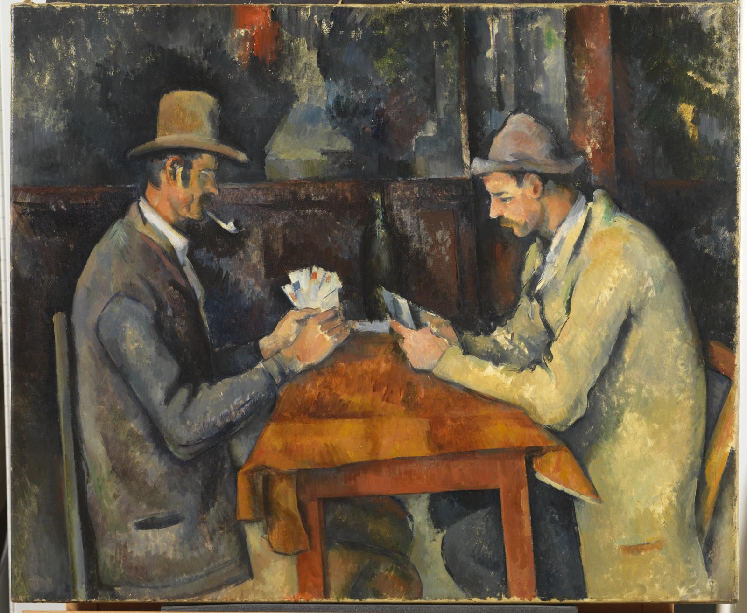
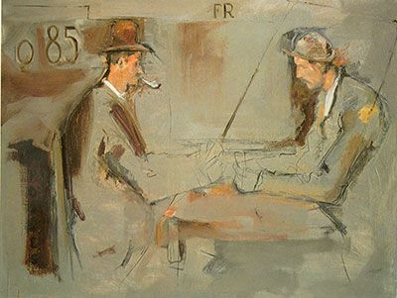
Left, Paul Cezanne, Card Players, oil on canvas, (ca.1894-1895) Height: 18.7 ″; Width: 57 22.4 ″
Right, Larry Rivers , Untitled, oil on canvas. (ca.1965)

Slide 4
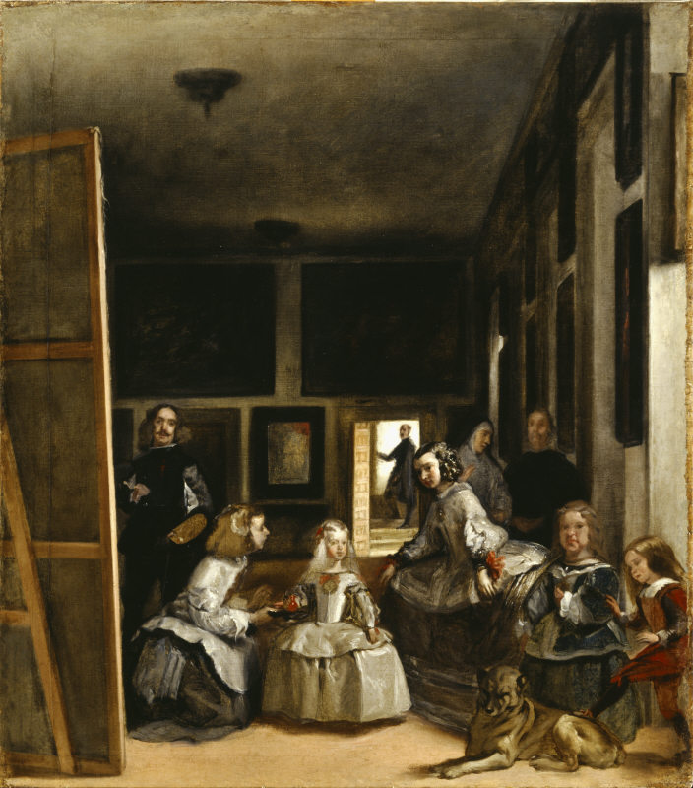
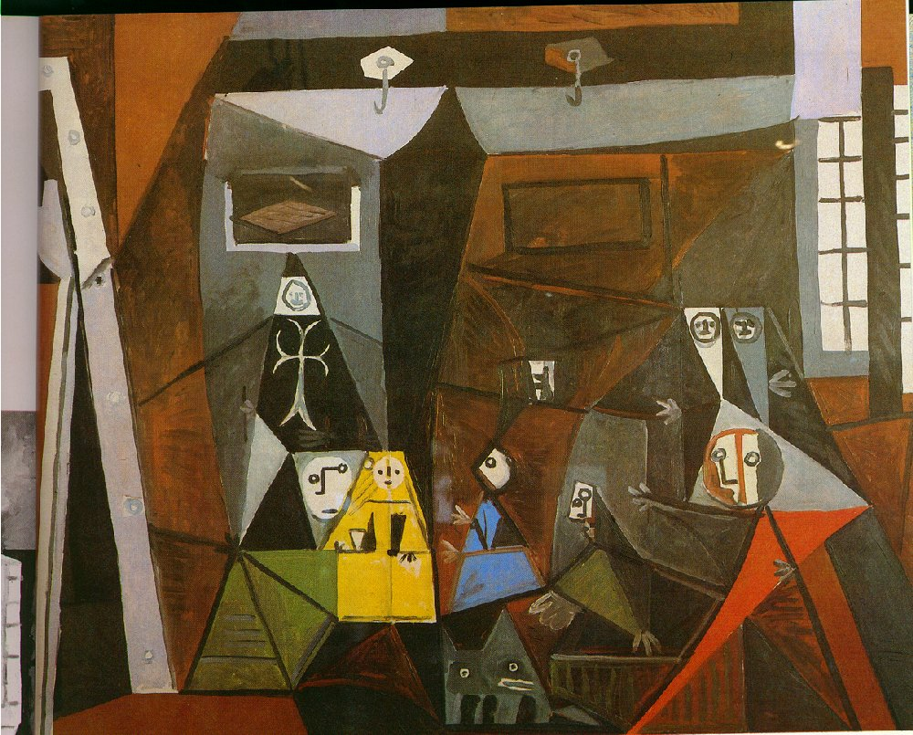
Left, Diego Velasquez, Las Meninas, oil oncanvas, 318 cm × 276 cm (125.2 in × 108.7 in) 1656
Right, Pablo Picasso, acrylic and oil on canvas, 1957

Slide 5
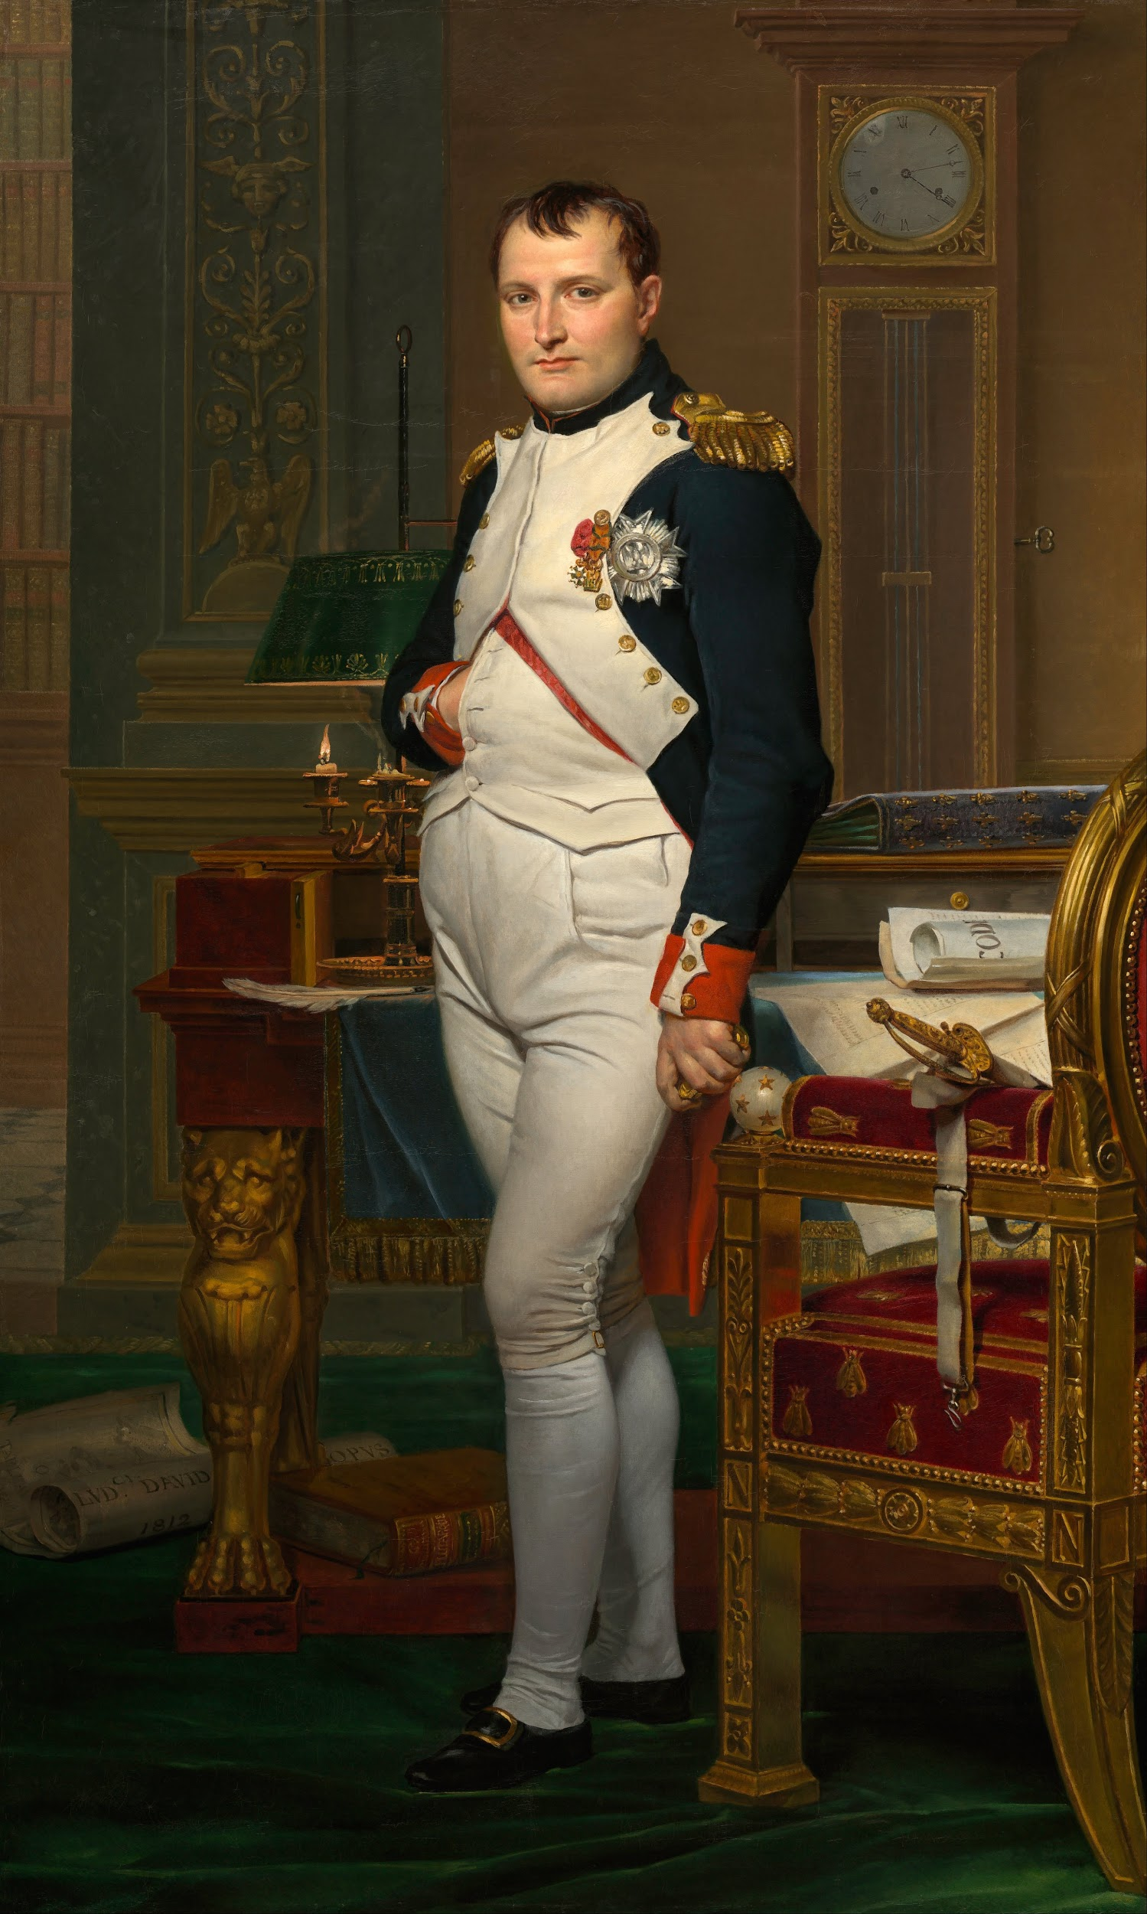
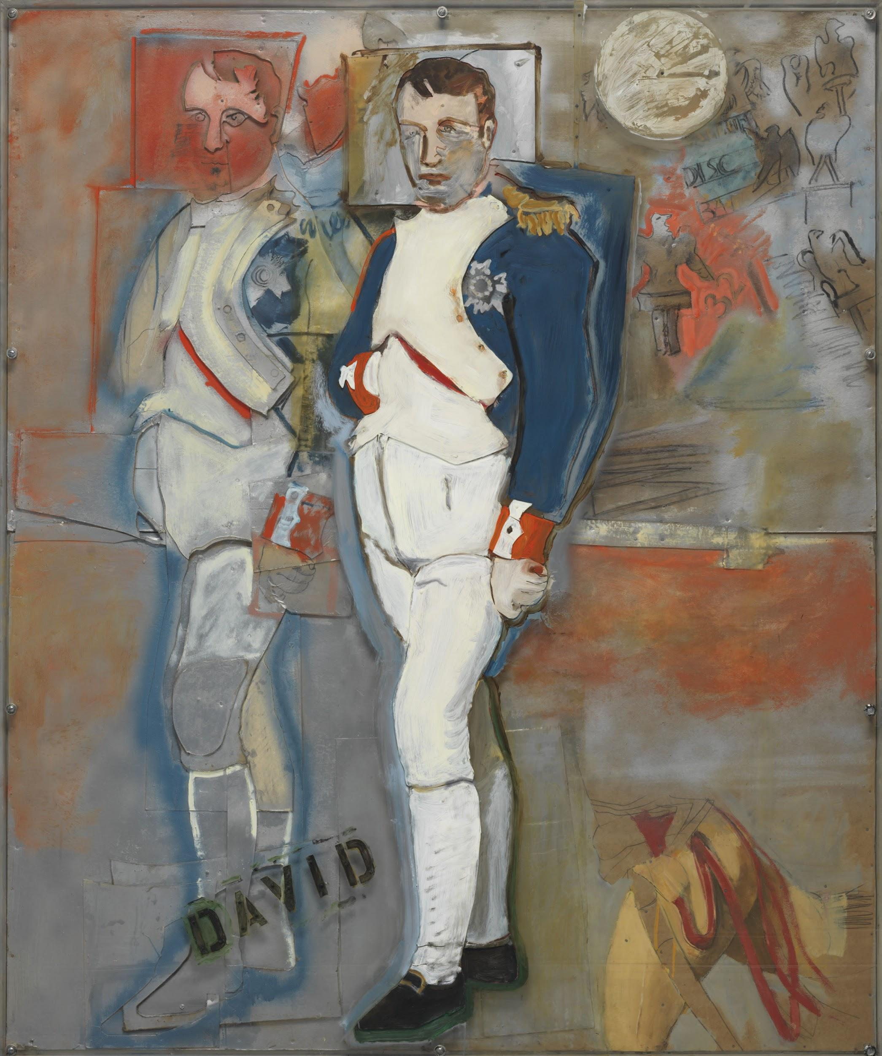
Left, Jacques-Louis David, The Emperor Napoleon in His Study at the Tuilerie, oil on canvas, 1812, Height: 80.27 ″; Width: 49.25 ″
Right, Larry Rivers (1923-2002) The Second Greatest Homosexual
acrylic, nails, wood collage and Plexiglas on cardboard construction laid down on panel
71 x 59 ¼ x 2 ½ in. (180.3 x 150.5 x 6.4 cm.)

Slide 6
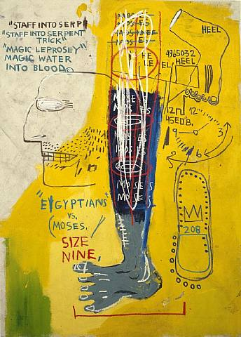
Left, Gray’s Anatomy, Lower leg, anterior view
Right, Jean-Michel Basquiat, Early Moses, acrylic and oil on canvas. 1983

Slide 7
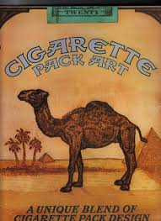
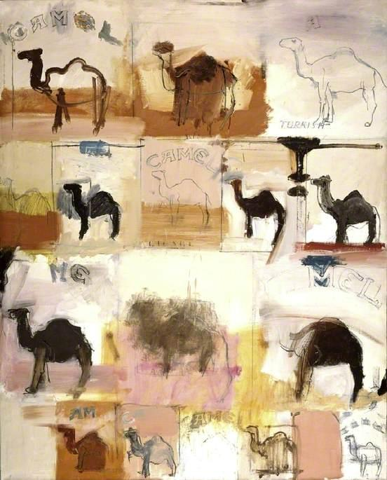
Left, Camel cigarettes package art
Right, Larry Rivers, CAmels, oil on canvas. (ca.1961)

